Slide 1

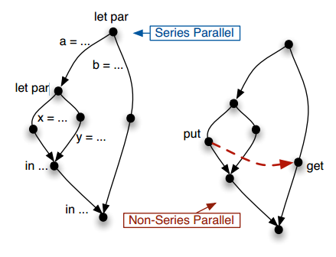
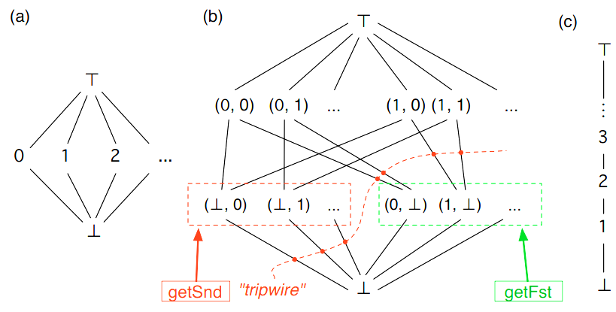
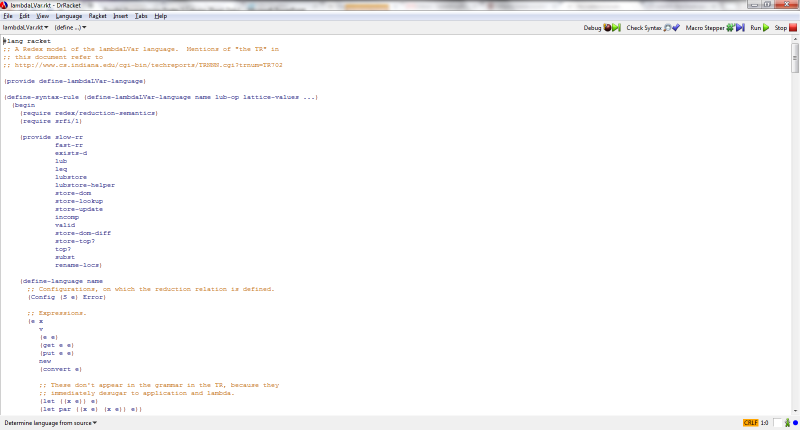

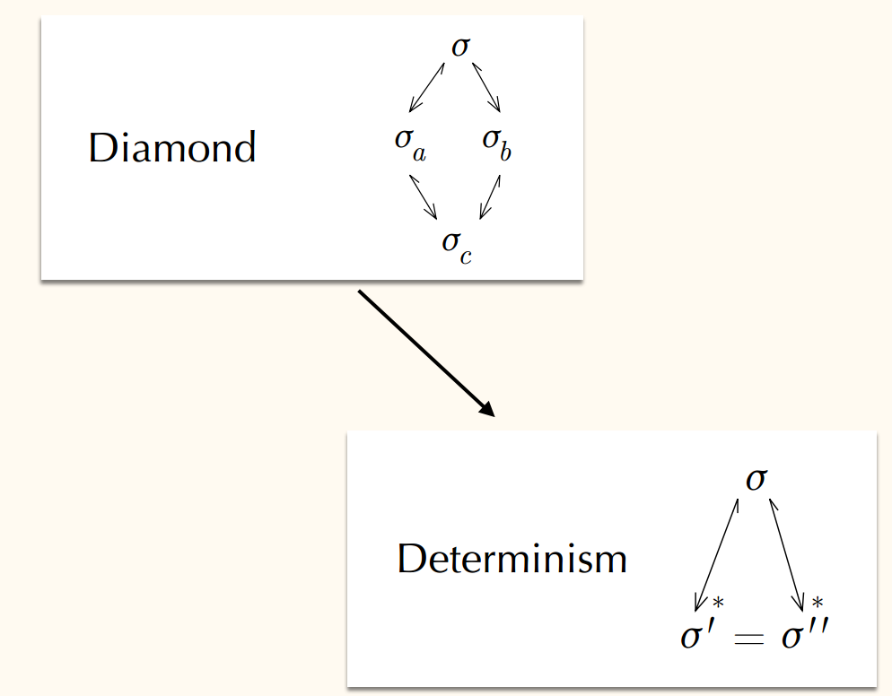

LVars for Parallel Programming
Isaiah Weating & Lindsey Kuper
School of Informatics and Computing - Indiana University
Introduction
The Problem
Parallel programming is a form of computation in which multiple calculations are carried out simultaneously, operating on the principle that large problems can often be divided into smaller ones, which are then solved concurrently. This allows programs to operate faster. Parallel programming without state isn’t that difficult. When you add state to the equation though, it begins to get more challenging. This begins to cause the program to become nondeterministic depending on the order of the parallel computations. A nondeterministic program could have different solutions dependent on the order which statements are called. Our goal is to create a language that will allow a program to run various operations in parallel while still remaining deterministic.
let par a = ... let par x = ... y = ... in ... b = ... in ...
let par a = ... let par x = ... Put(l) ... y = ... in ... b = ... Get(l) ... in ...
Before I began working on this project, there was already an implementation of the counter lvar, c, that allows the user to put a value in and if you attempted to get a value, it will return true as long as that value doesn’t exceed the max value, the value that was put into the lvar.
Lvar B allows for pairs of values.
Tools Used
We developed our language in Reddex. Reddex is a programming language used for creating programming languages which is embedded in the racket language. Our development software of choice was Dr. Racket, shown below.
Determinism for λ LVar
Future Work
Info written by Lindsey
various headings..
The problem
Our contribution
Materials and methods should talk about redex anc racket
Future of Project
Contacts
Isaiah Weating --- iweating@indiana.edu
Lindsey Kuper – lkuper@cs.indiana.edu

